Slide 1
Case Study by A Major Travel Company
SQL for Data Analytics

Slide 2
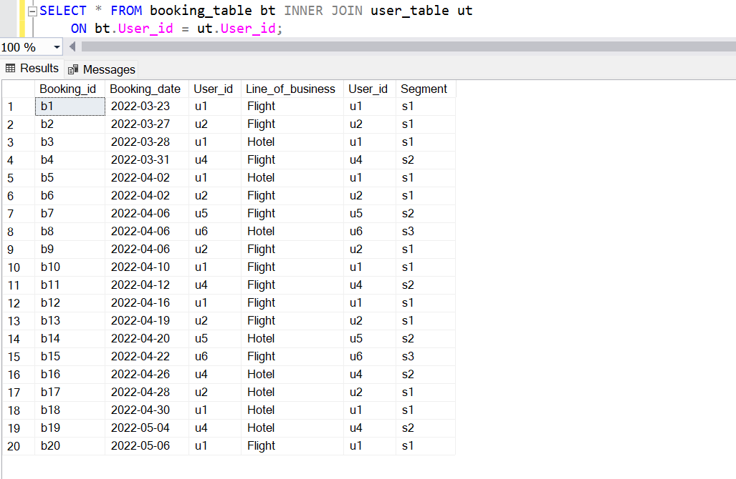
Dataset:

Slide 3
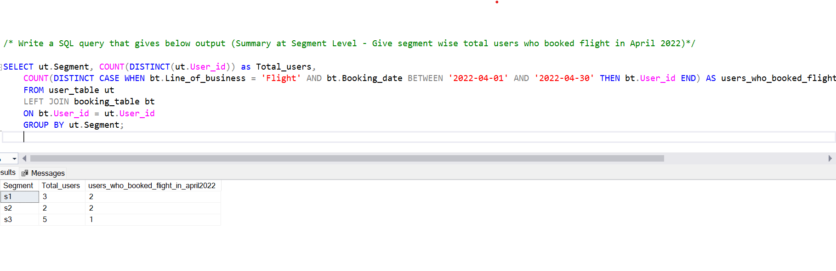
1. Write a SQL query that gives segment wise total users who booked flight in April 2022.

Slide 4
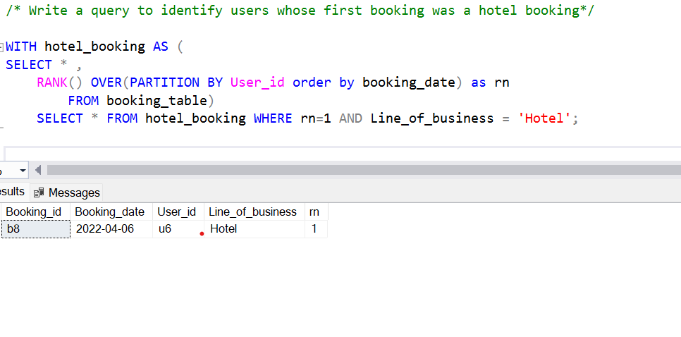
2. Write a query to identify users whose first booking was a hotel booking.

Slide 5
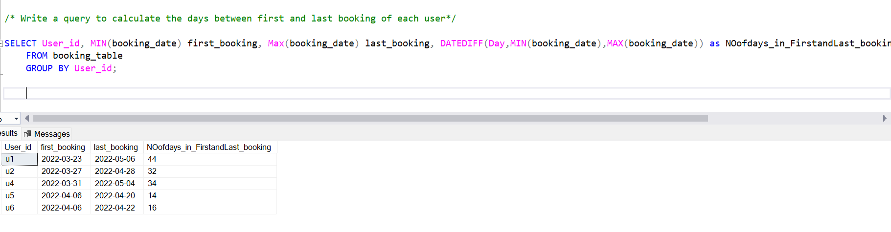
3. Write a query to calculate the days between first and last booking of each user.

Slide 6
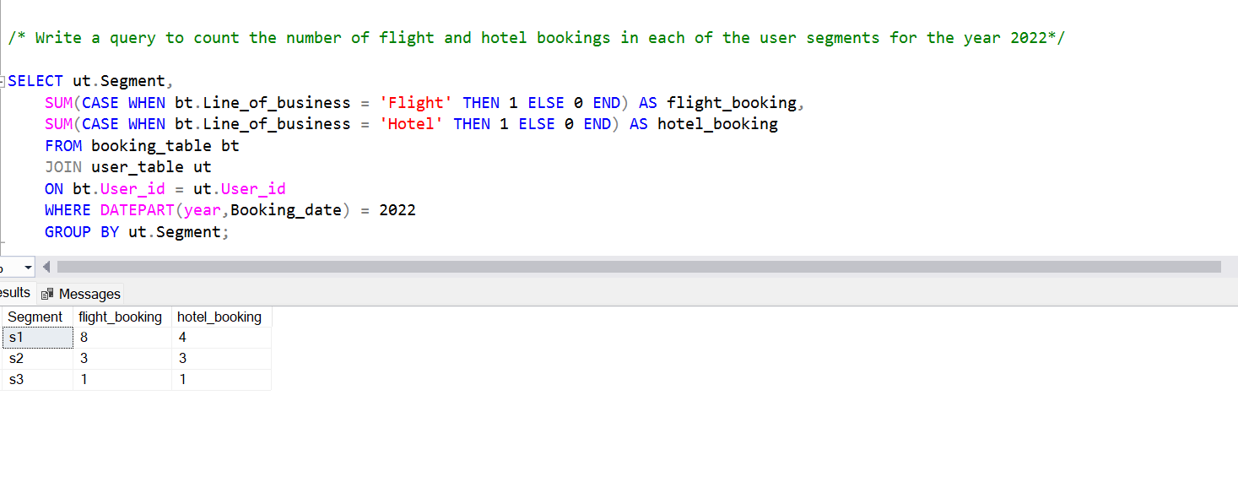
4. Write a query to count the number of flight and hotel bookings in each of the user segments for the year 2022.

